Slide 1
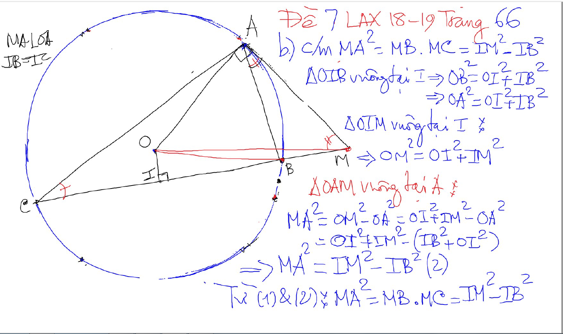
CONG THUC – SO HOC

Slide 2
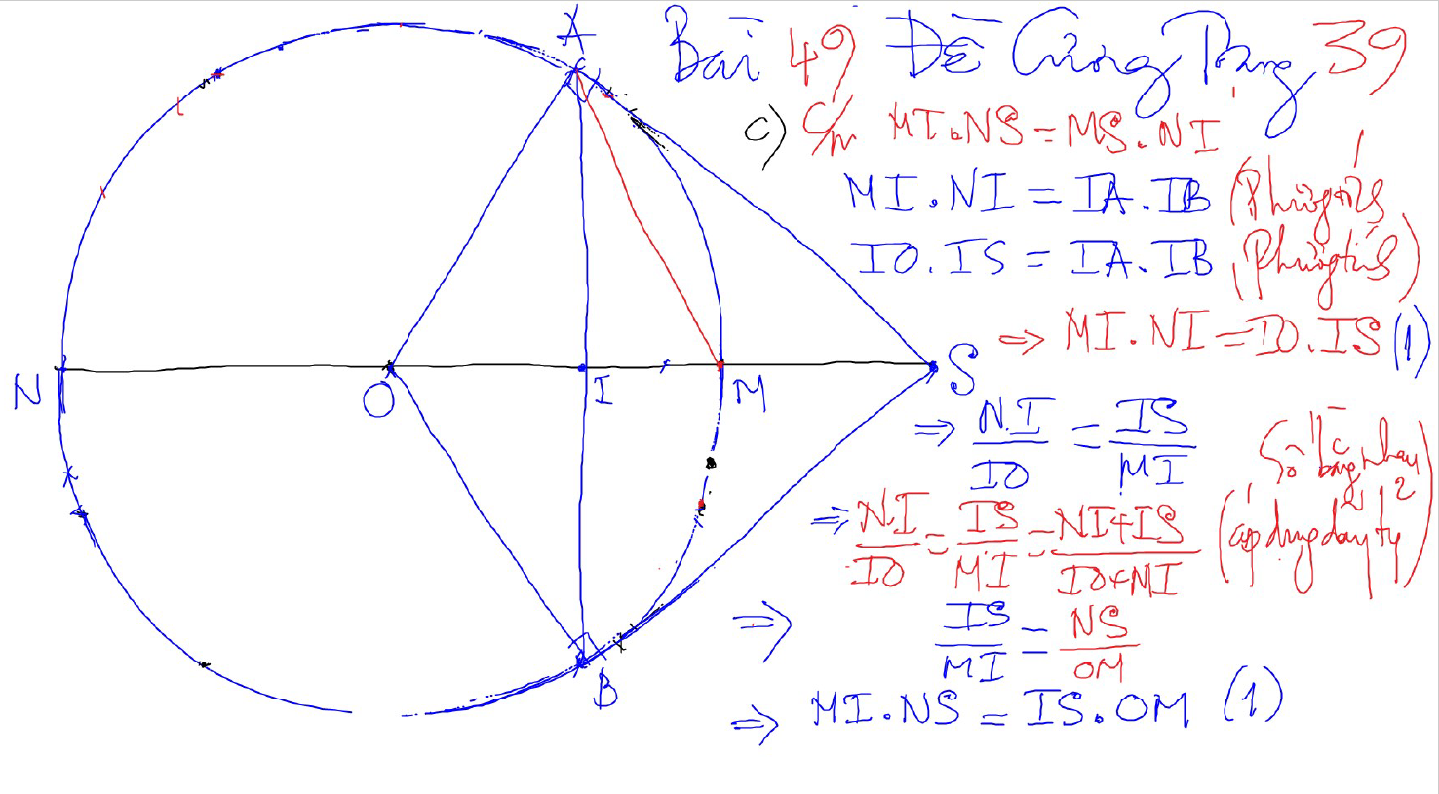
CONG THUC – SO HOC

Slide 3
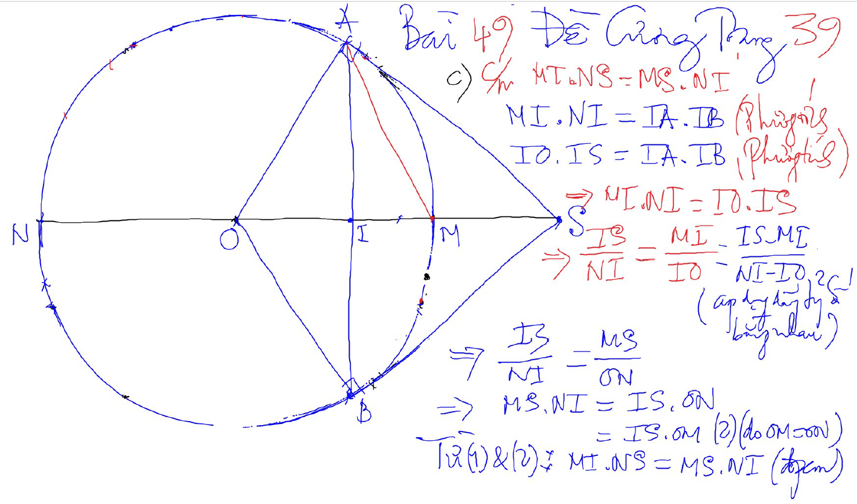
CONG THUC – SO HOC

Slide 4
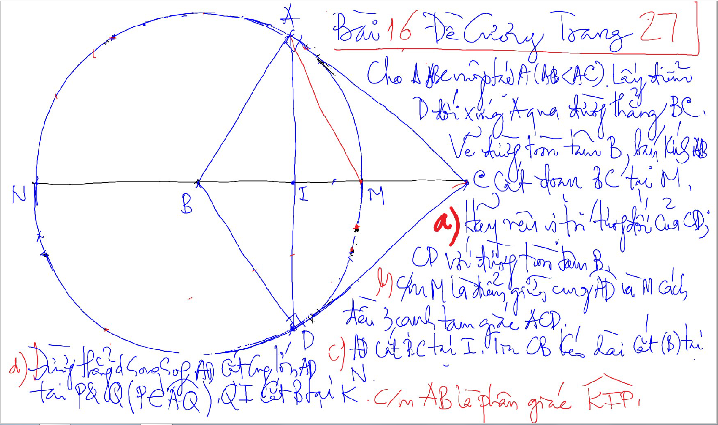
CONG THUC – SO HOC

Slide 5
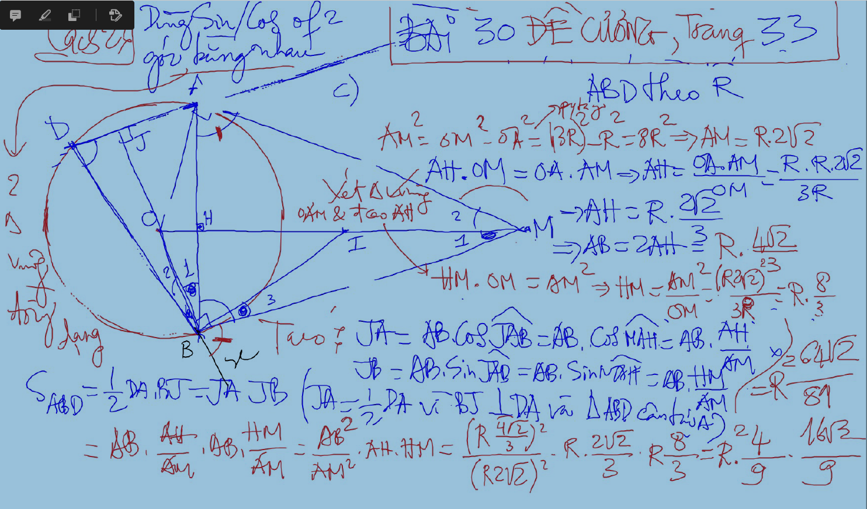
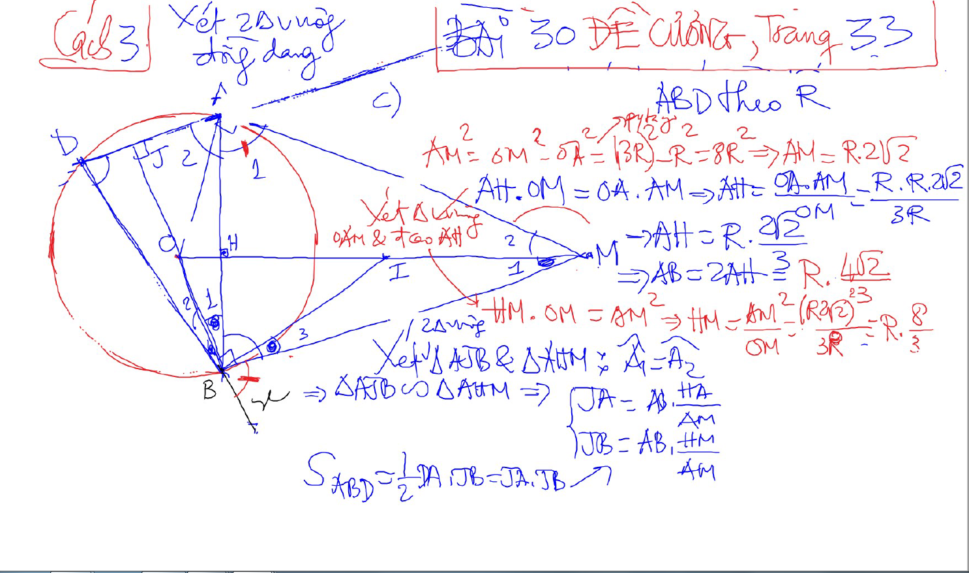
CONG THUC – SO HOC

Slide 6
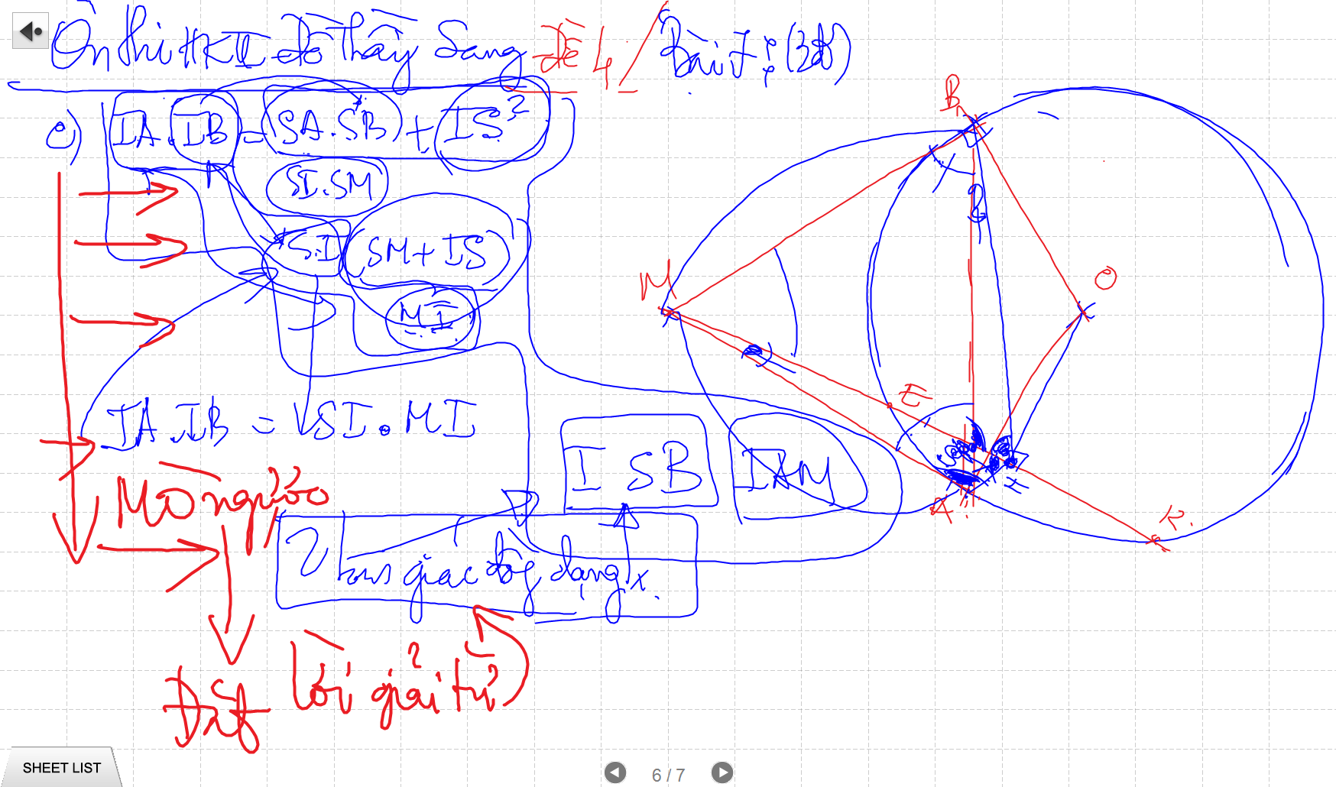
CONG THUC – SO HOC

Slide 7
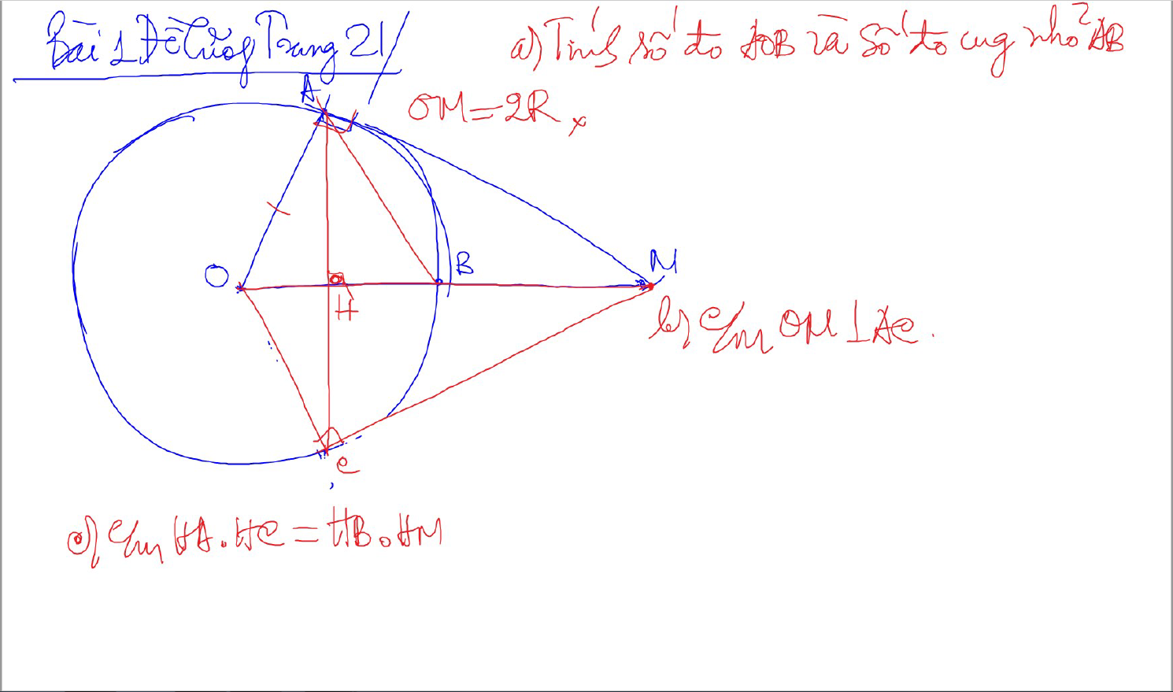
TINH SO DO GOC

Slide 8
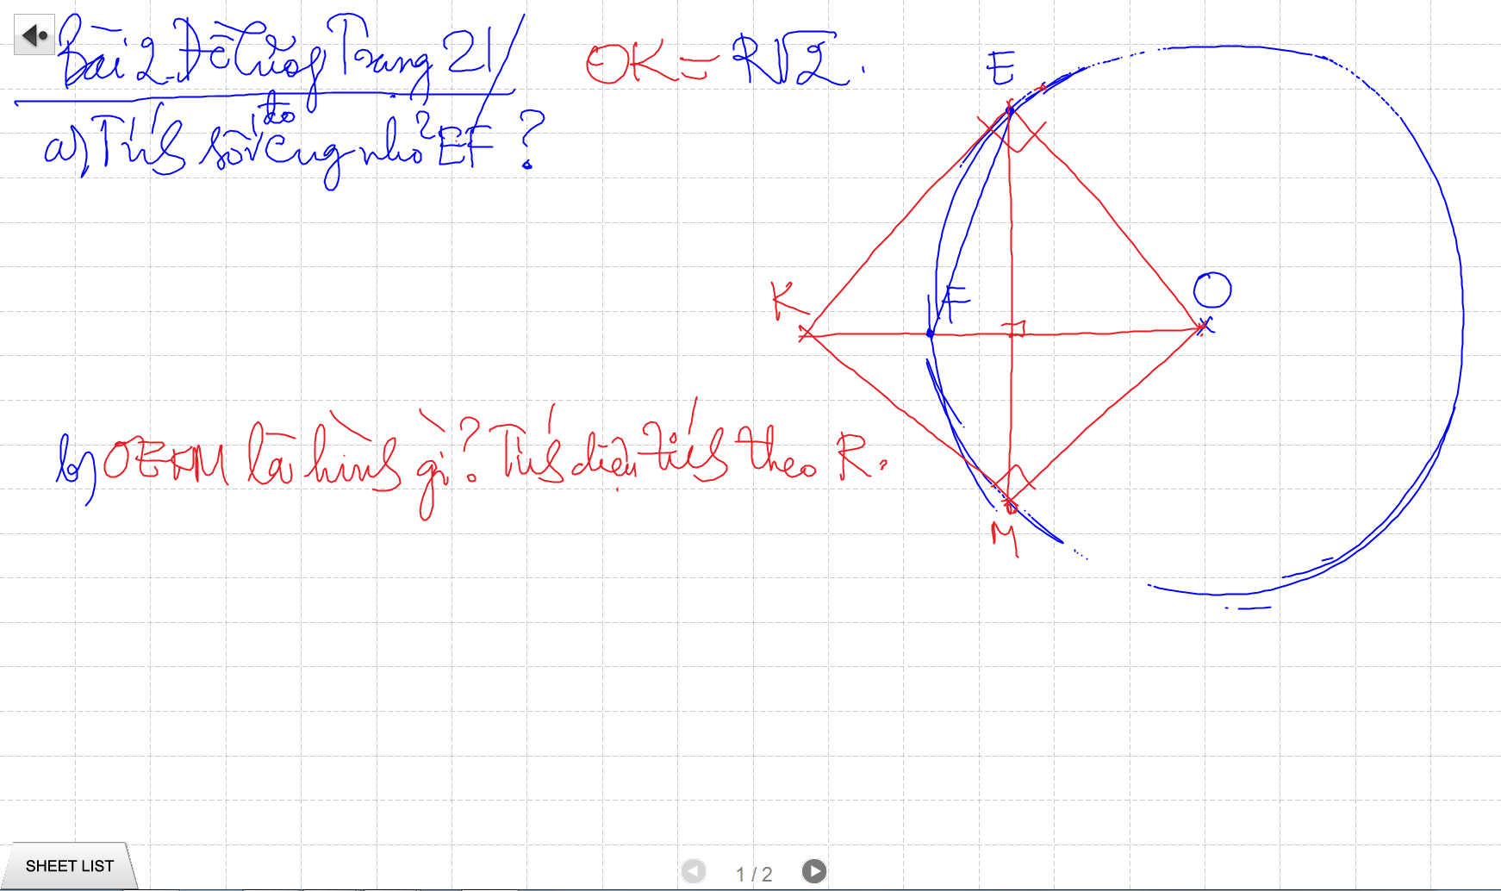
TINH SO DO GOC

Slide 9
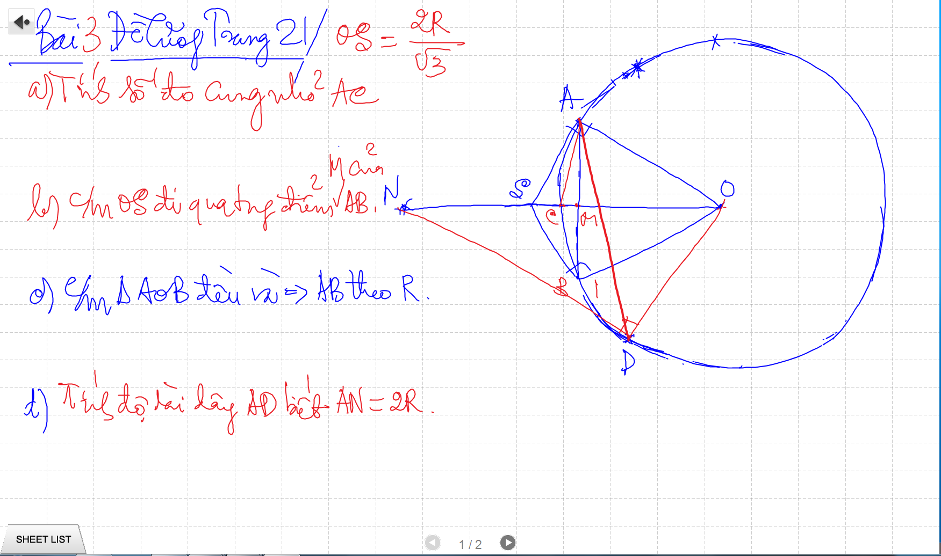
TINH SO DO GOC

Slide 10
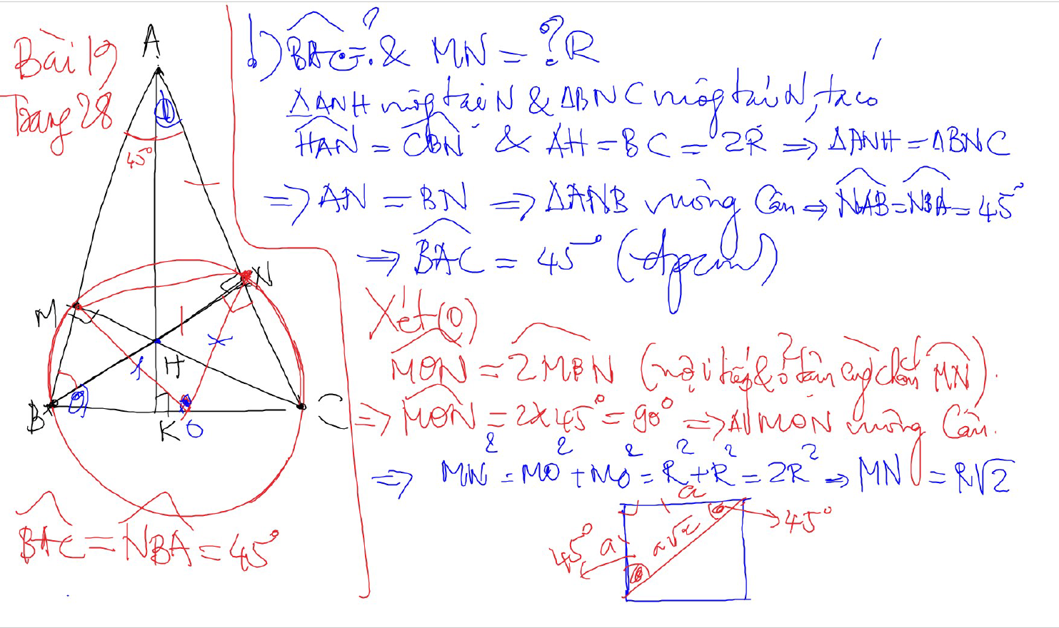
TINH SO DO GOC

Slide 11
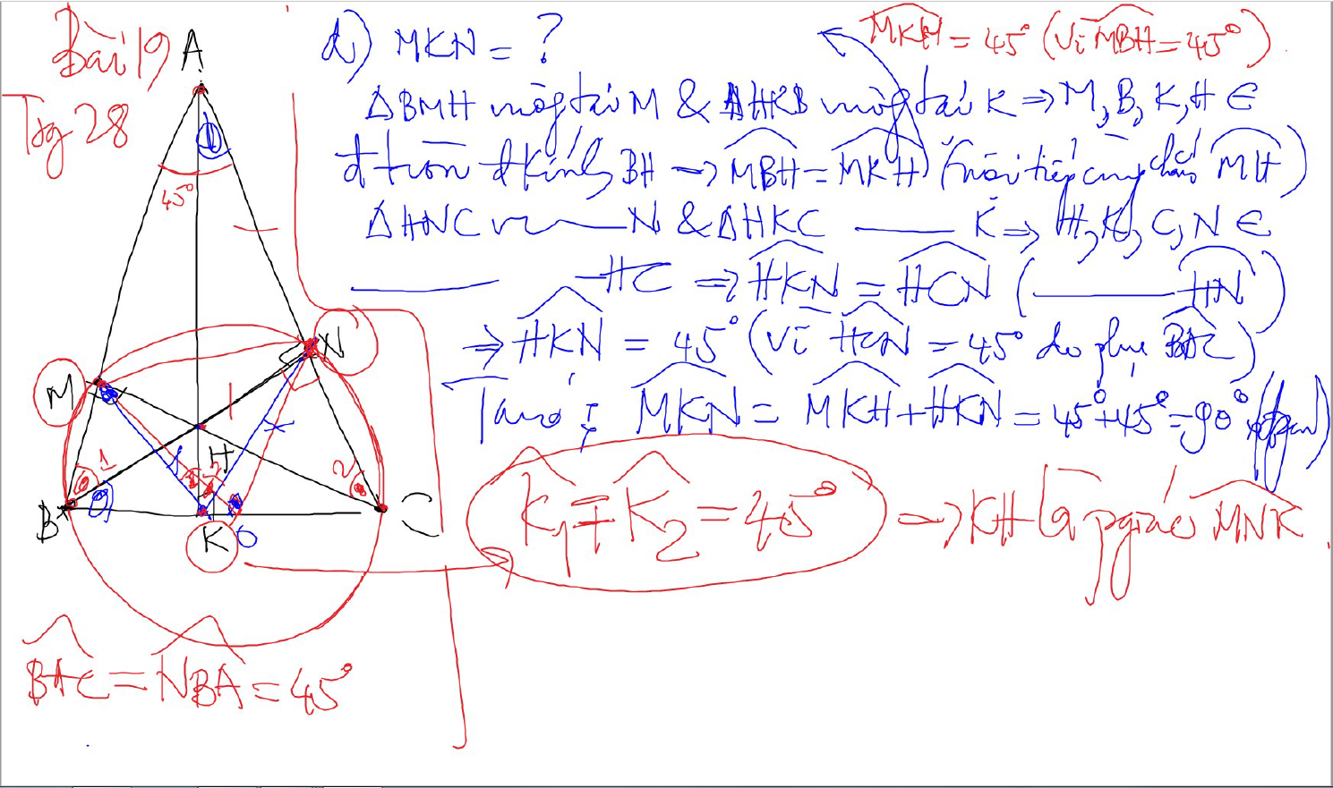
TINH SO DO GOC

Slide 12
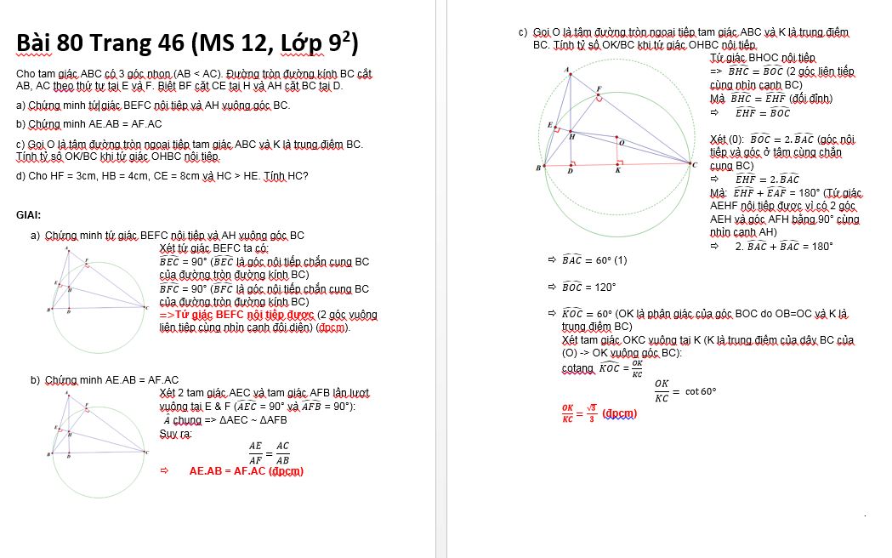
TINH SO DO GOC

Slide 13
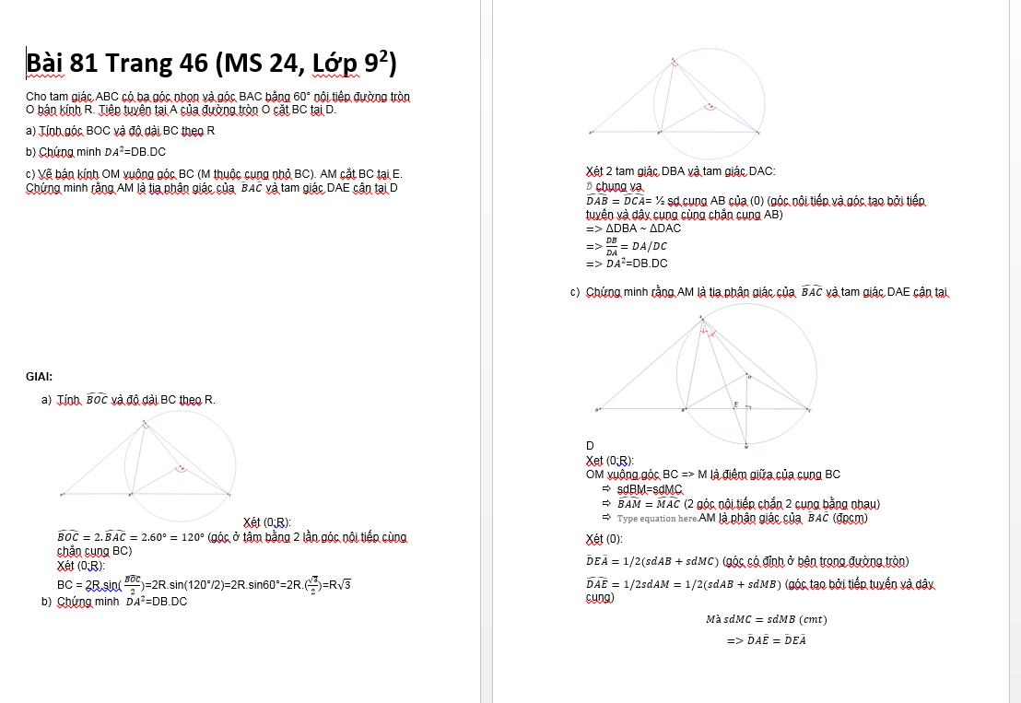
TINH SO DO GOC

Slide 14
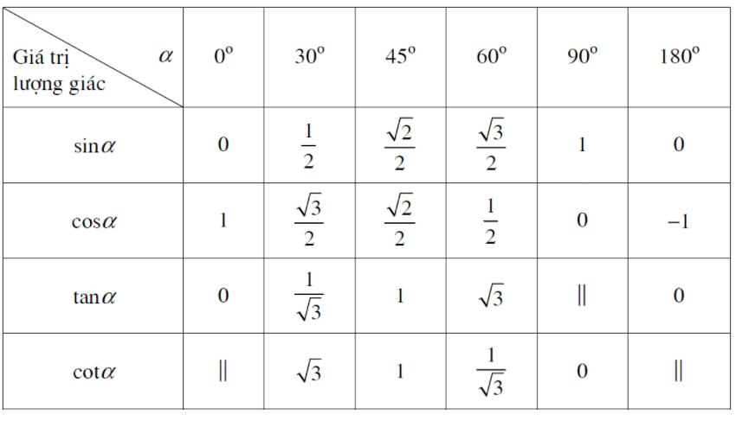
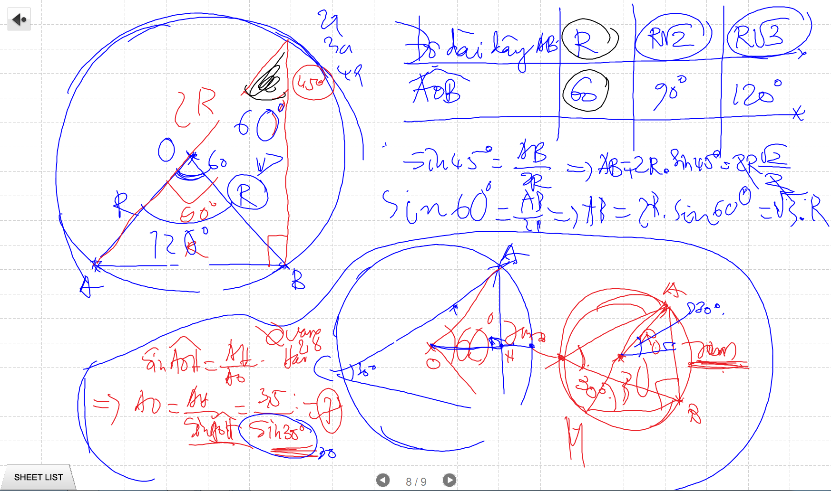
TINH SO DO GOC

Slide 15
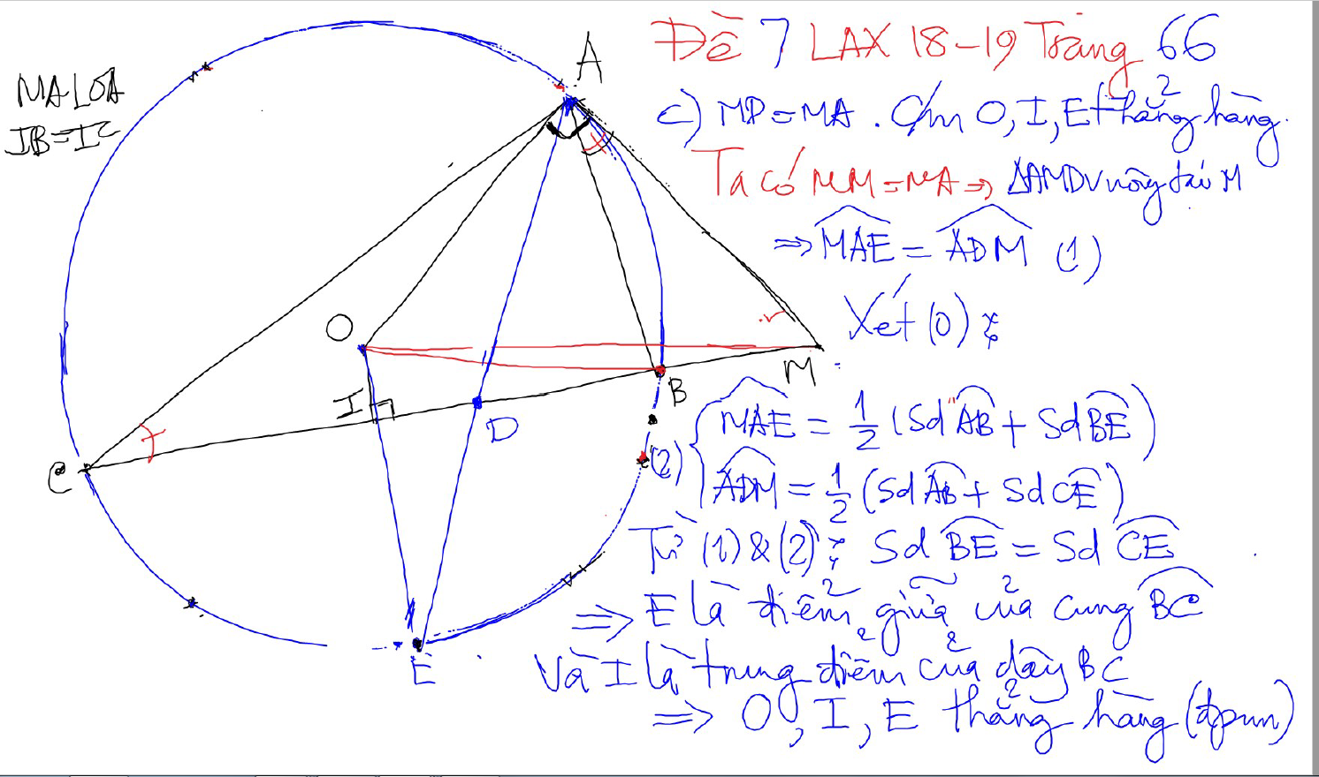
CHUNG MINH THANG HANG

Slide 16
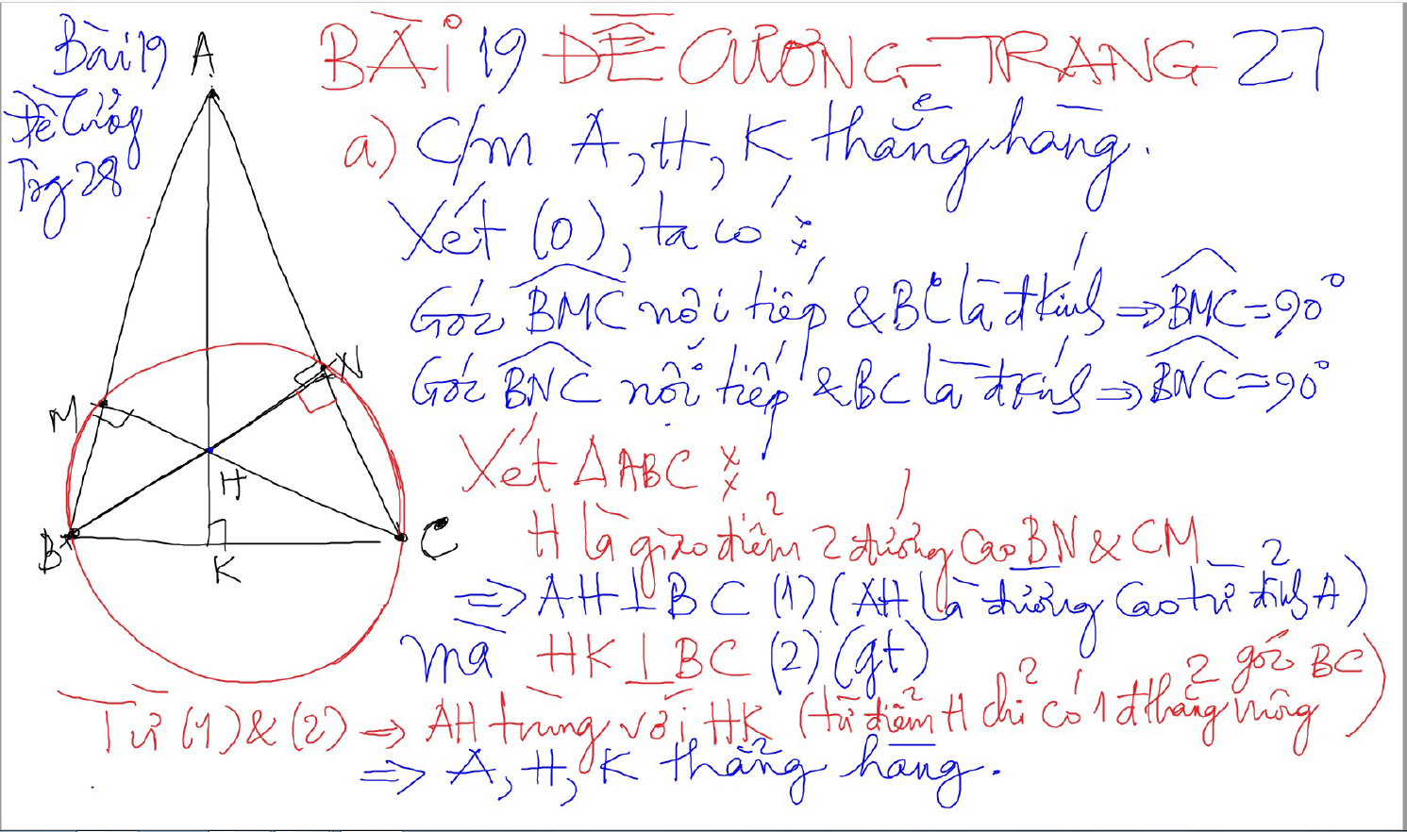
CHUNG MINH THANG HANG – 2 doan thang co 1 diem chung va cung vuong goc voi 1 dthang

Slide 17
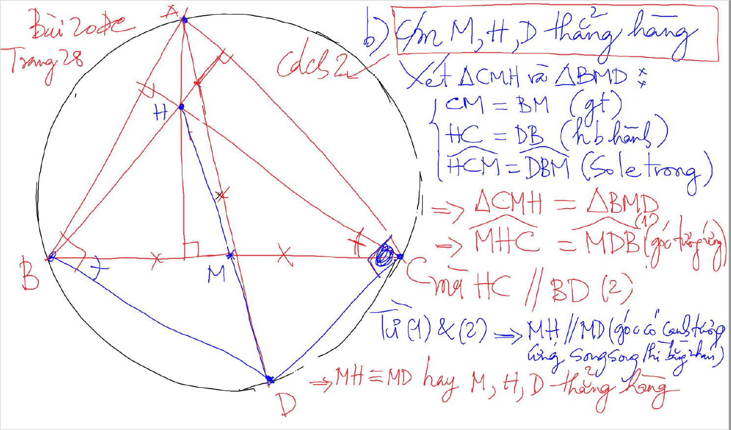
CHUNG MINH THANG HANG – 2 doan thang co mot diem chung va song song -> thang hang

Slide 18
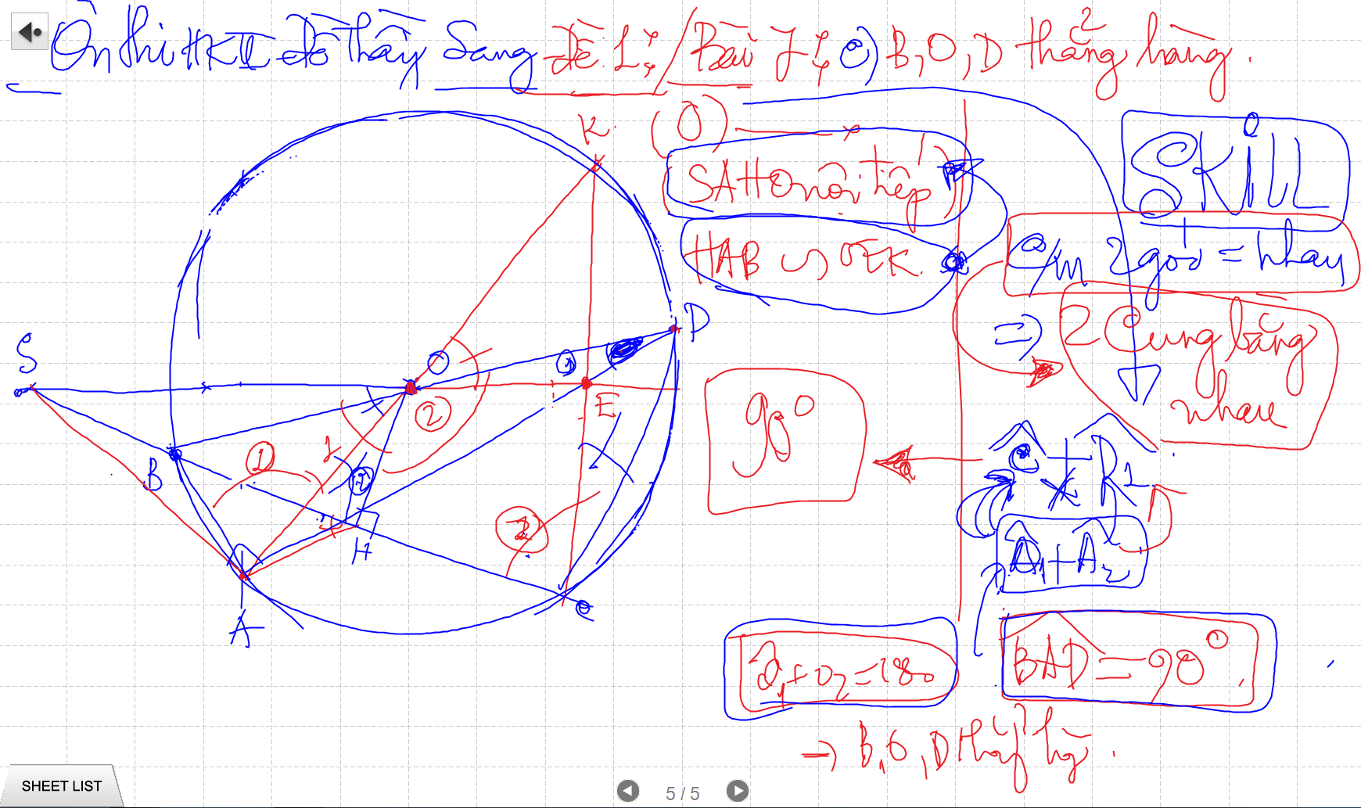
CHUNG MINH THANG HANG – 2 doan thang co mot diem chung va song song -> thang hang

Slide 19
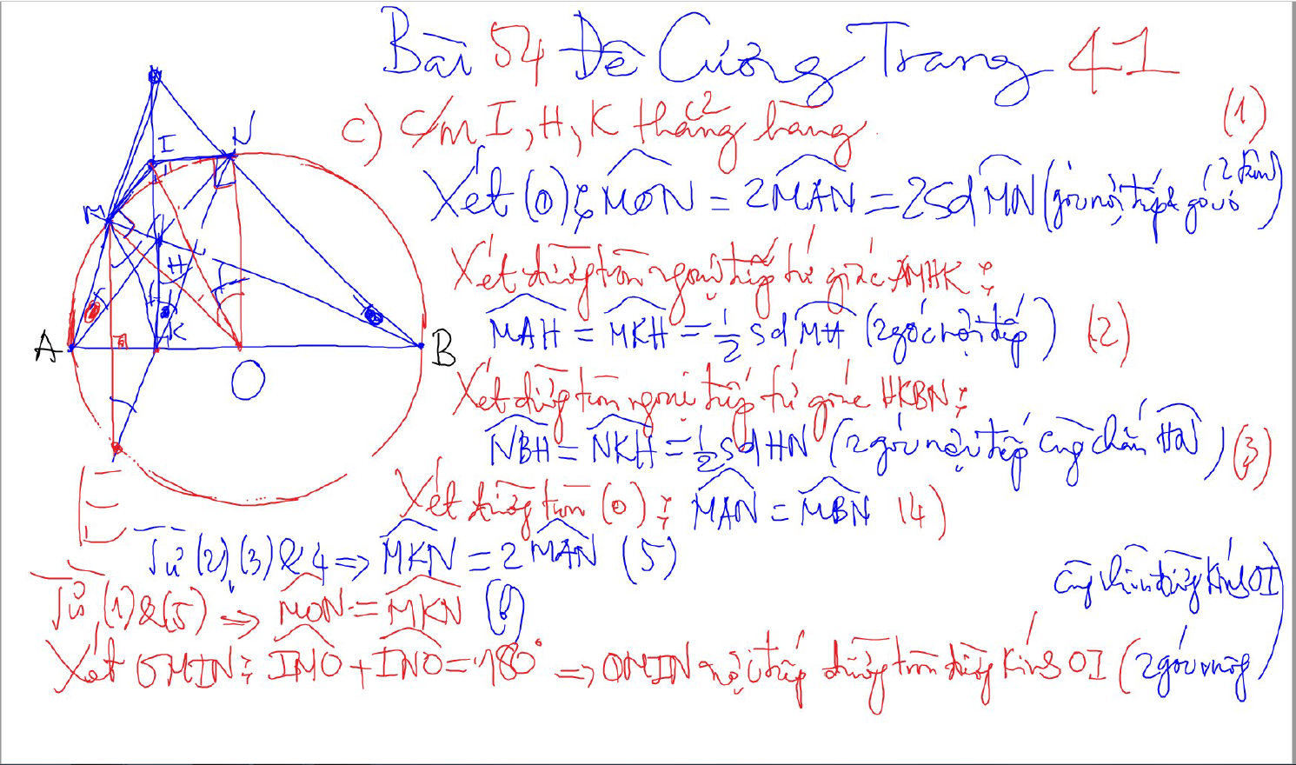
CHUNG MINH THANG HANG – 2 doan thang co 1 diem chung va cung vuong goc voi 1 dthang

Slide 20
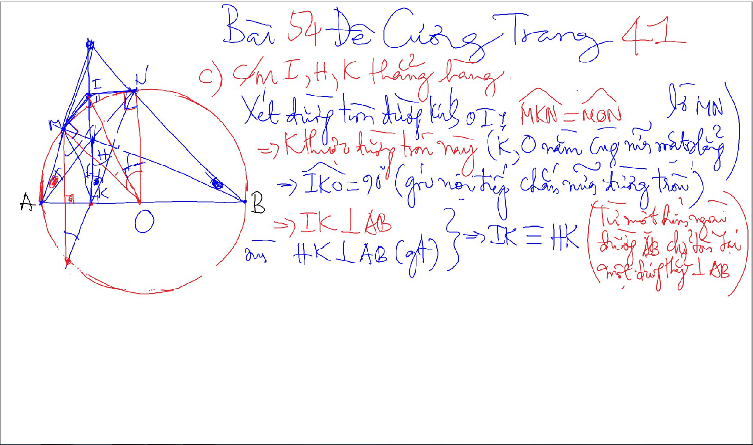
CHUNG MINH THANG HANG – 2 doan thang co 1 diem chung va cung vuong goc voi 1 dthang

Slide 21
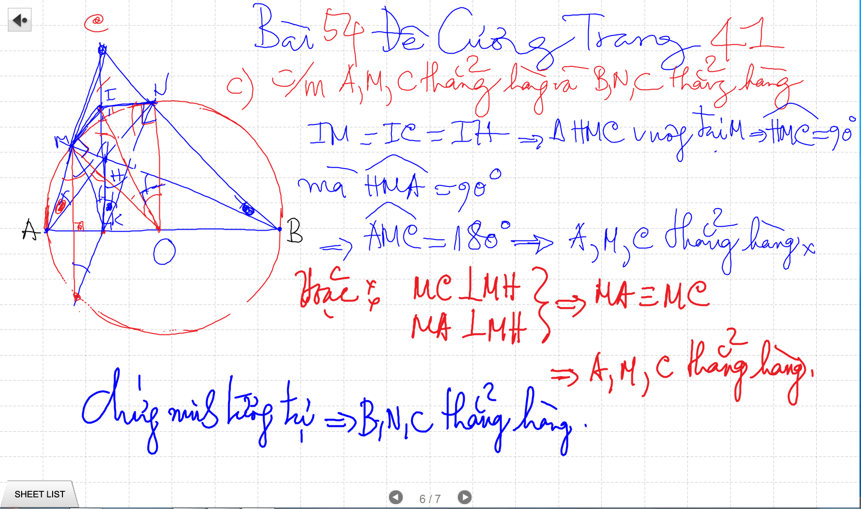
CHUNG MINH THANG HANG – 2 doan thang co 1 diem chung va cung vuong goc voi 1 dthang

Slide 22
CHUNG MINH THANG HANG – 2 doan thang co 1 diem chung va cung vuong goc voi 1 dthang

Slide 23
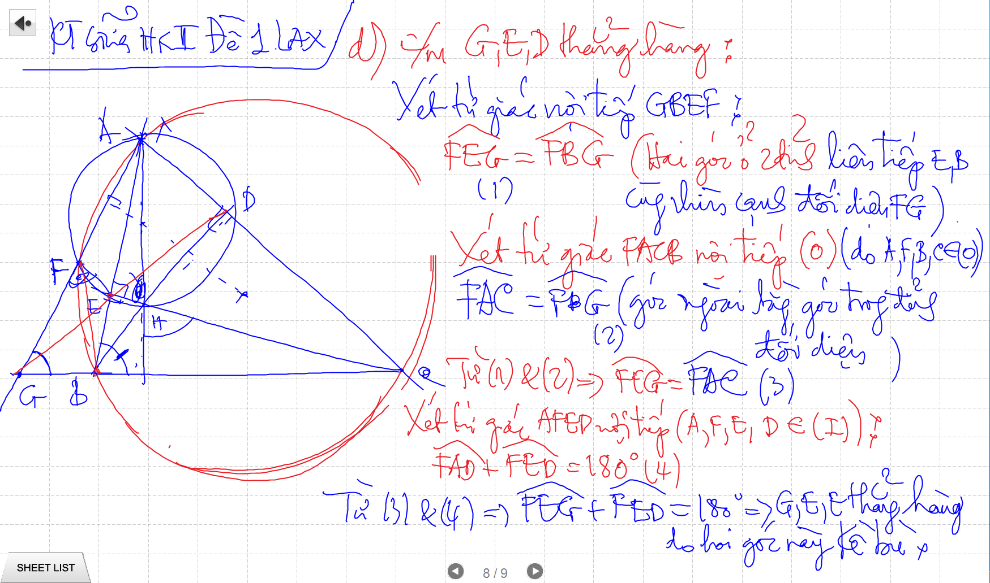
CHUNG MINH THANG HANG – 2 doan thang co 1 diem chung va cung vuong goc voi 1 dthang

Slide 24
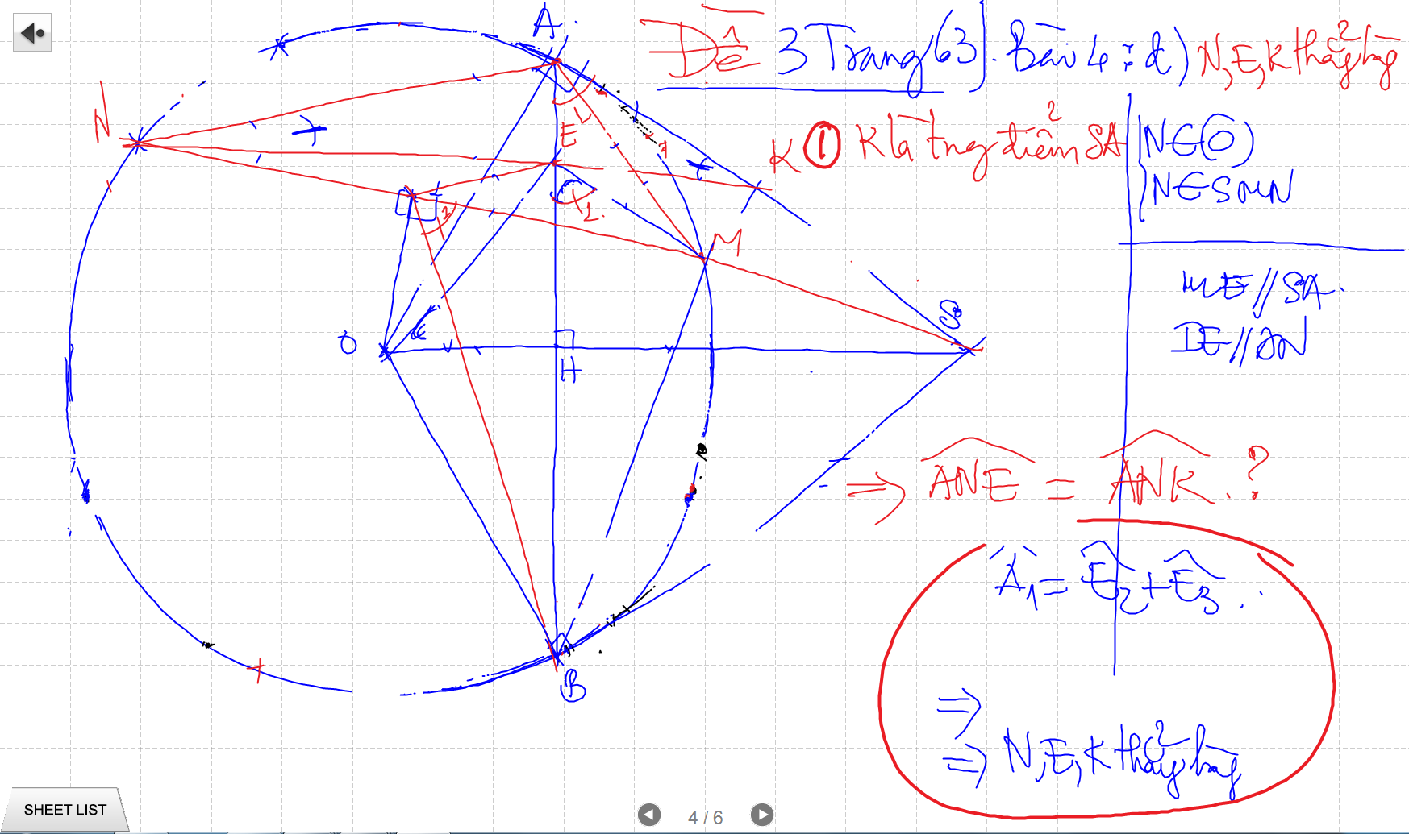
CHUNG MINH THANG HANG – 2 doan thang co 1 diem chung va cung vuong goc voi 1 dthang

Slide 25
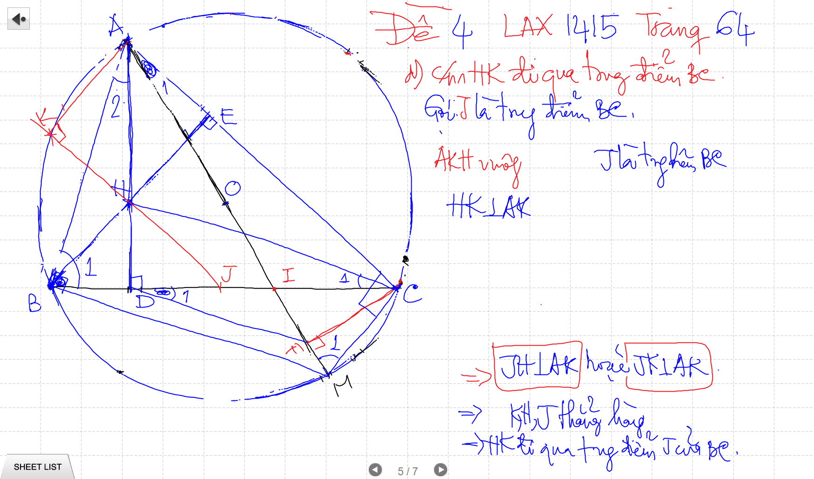
CHUNG MINH THANG HANG – 2 doan thang co 1 diem chung va cung vuong goc voi 1 dthang

Slide 26
CHUNG MINH THANG HANG – 2 doan thang co 1 diem chung va cung vuong goc voi 1 dthang

Slide 27
CHUNG MINH THANG HANG – 2 doan thang co 1 diem chung va cung vuong goc voi 1 dthang

Slide 28
CHUNG MINH THANG HANG – 2 doan thang co 1 diem chung va cung vuong goc voi 1 dthang

Slide 29
CHUNG MINH THANG HANG – 2 doan thang co 1 diem chung va cung vuong goc voi 1 dthang

Slide 30
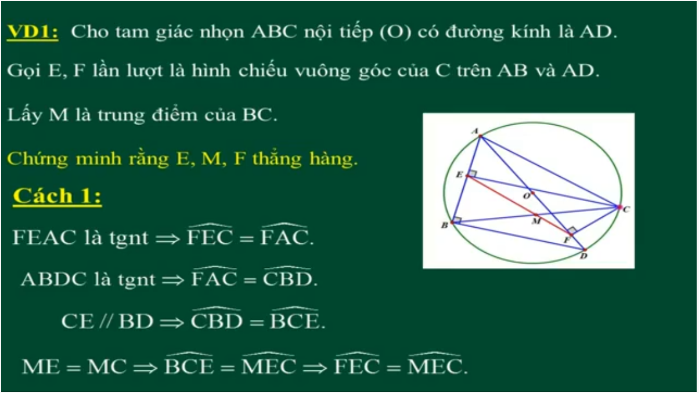
CHUNG MINH THANG HANG – 2 goc bang nhau co 1 canh chung

Slide 31
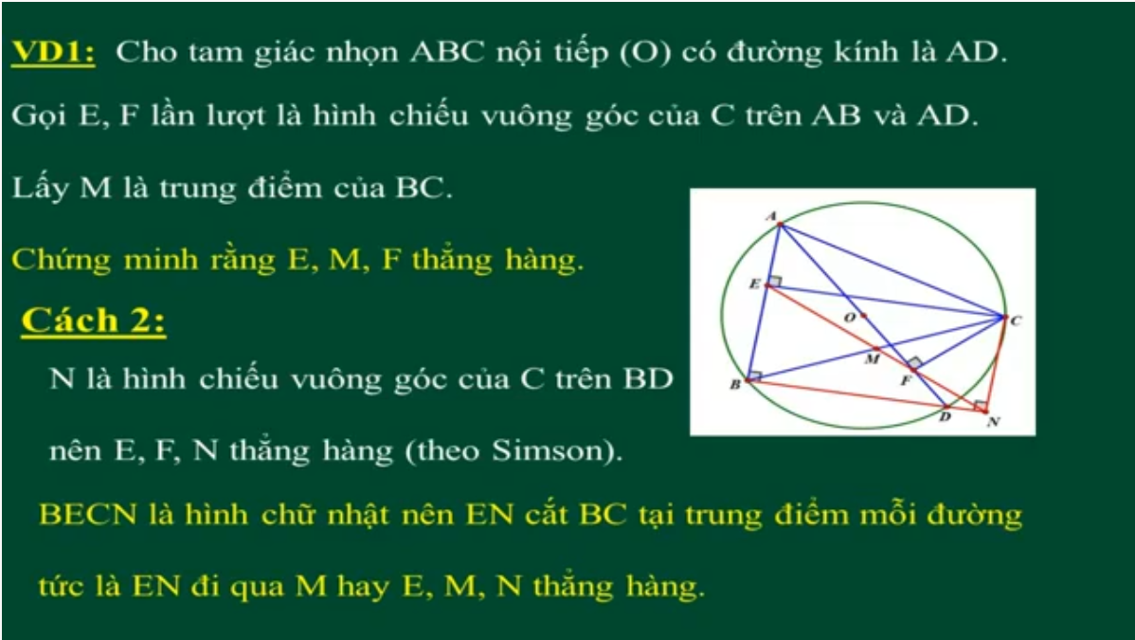
CHUNG MINH THANG HANG – 2 goc bang nhau co 1 canh chung

